Slide 1
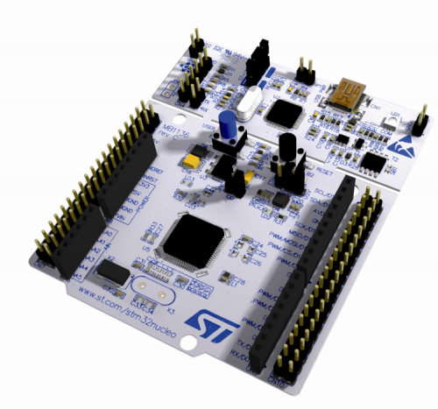
CAOS Project - BoardOS - Group 17
BoardOS
STM32 Nucleo-F446RE
Master Degree in Cybersecurity, academic year 2023/24
Course of Computer Architecture & Operating Systems
Professor: Stefano Di Carlo
Students: Francesco Corvaglia, Niccolò Lentini, Flavio Mastrorocco, Amalia Vittoria Montemurro, Paolo Tiecco

Slide 2
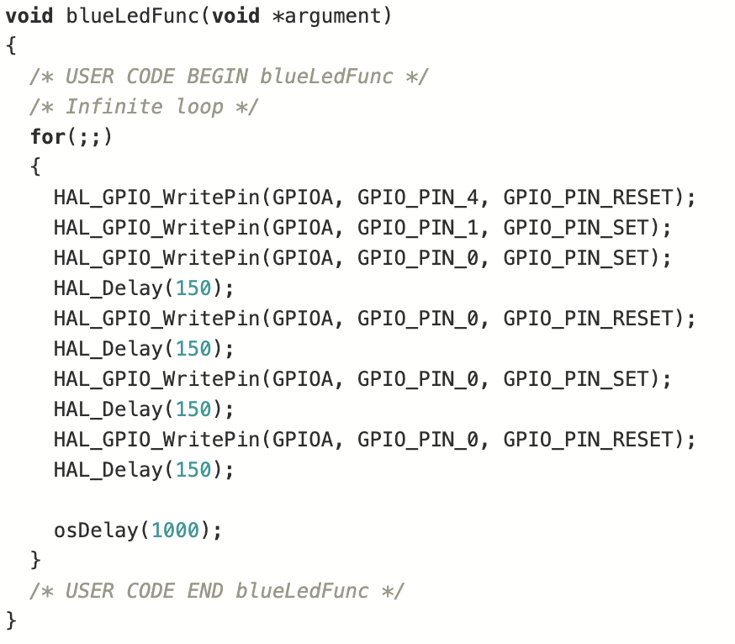
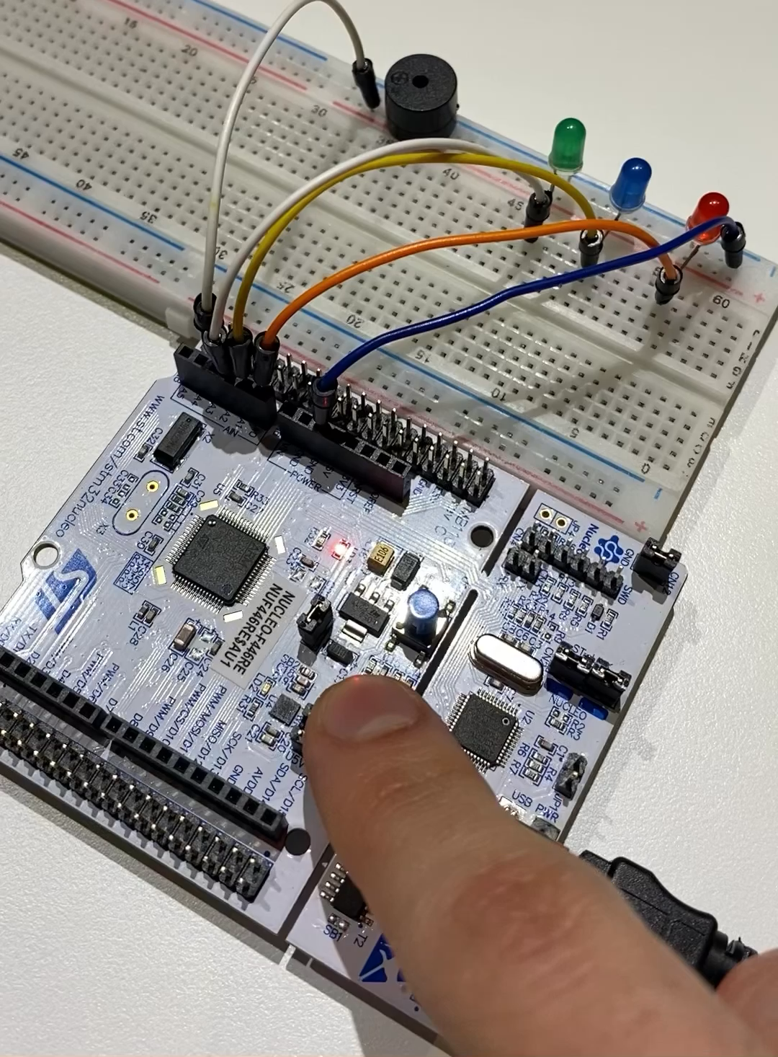
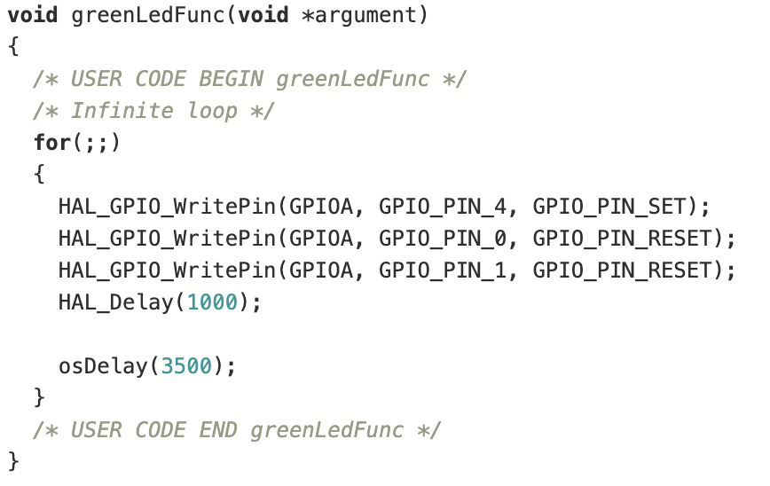
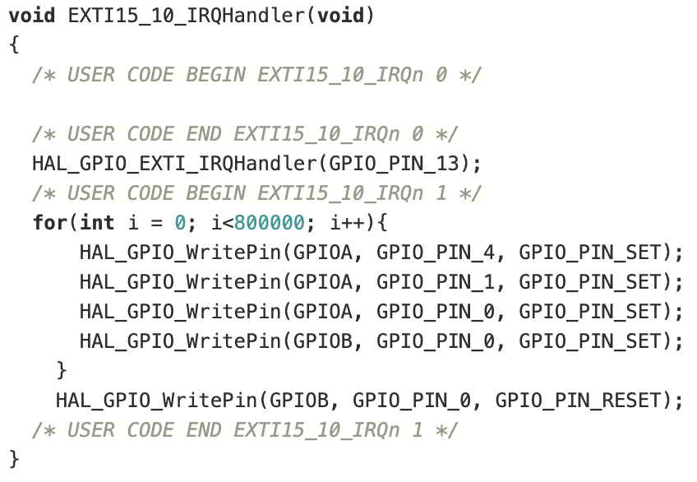
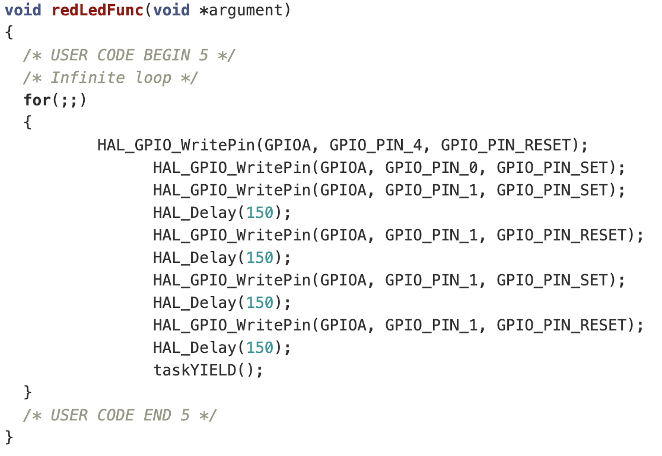
Practical Examples
Prioritized Preemptive Scheduling with Time Slicing
Prioritized Preemptive Scheduling without Time Slicing
Cooperative Scheduling

Slide 3
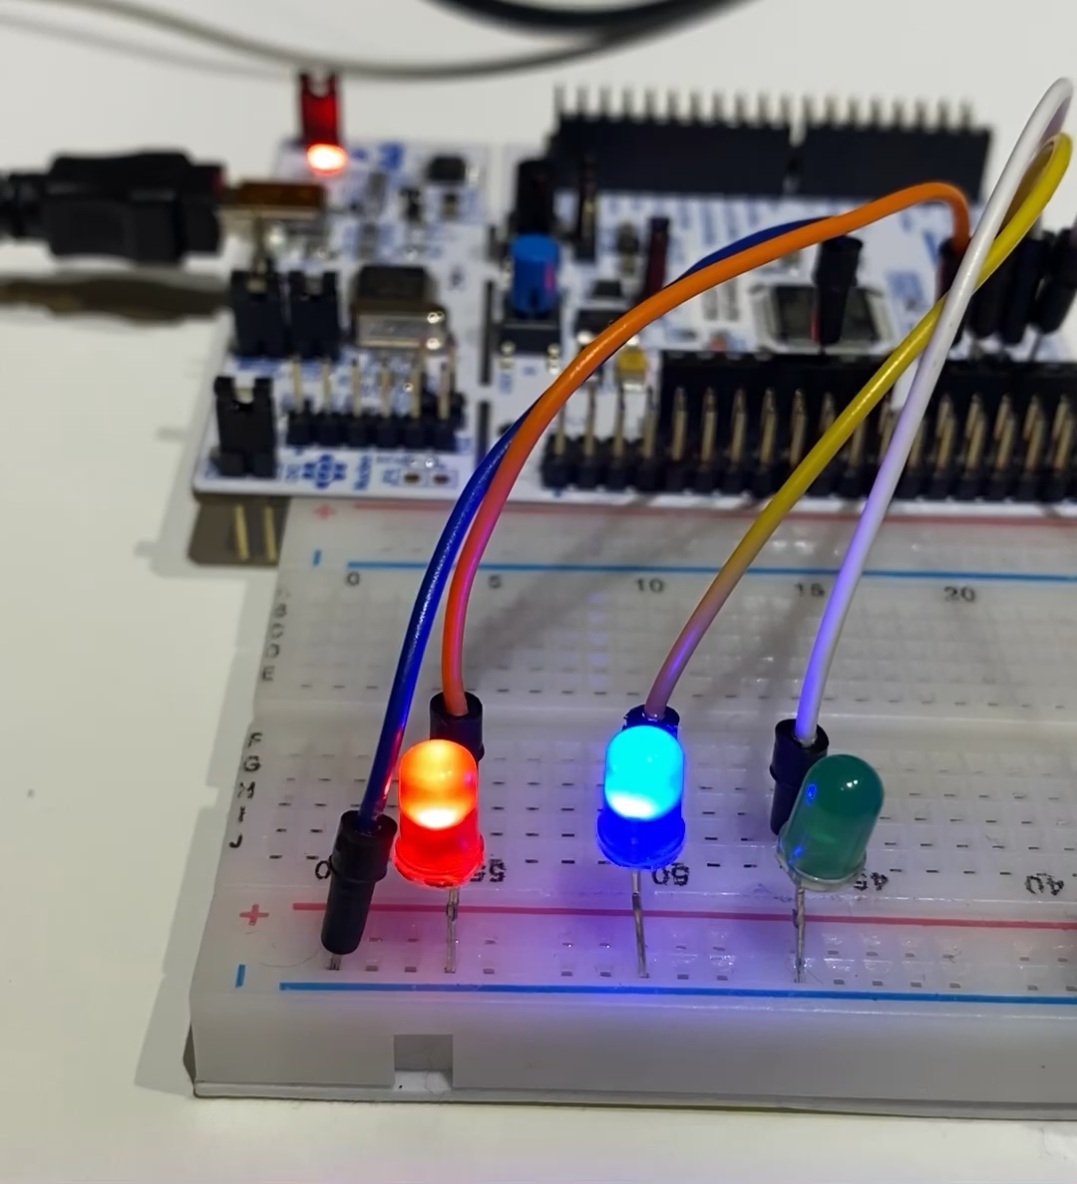
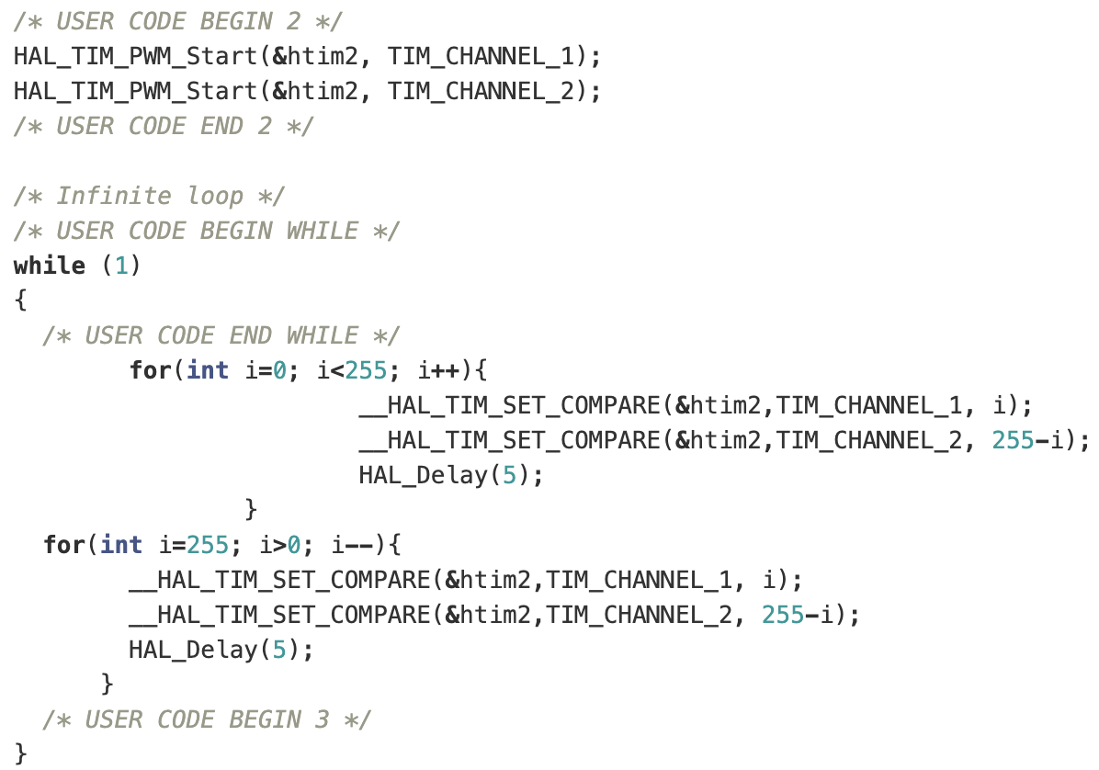
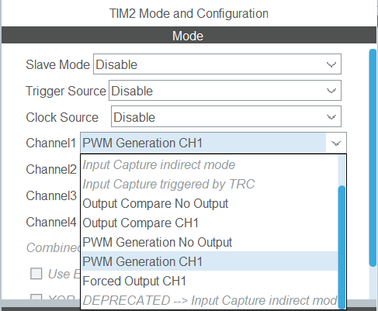
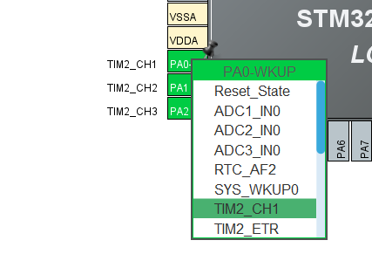
Practical Examples
PWM (Pulse Width Modulation)

Slide 4
Inter-Thread Communication
In most applications, threads need to communicate with each other or access shared resources together. The CMSIS-RTOS API provides various ways for exchanging messages between threads:
Resource Sharing
Binary Semaphore
Inter-Thread Communication
Message Queue
Mail Queue

Slide 5
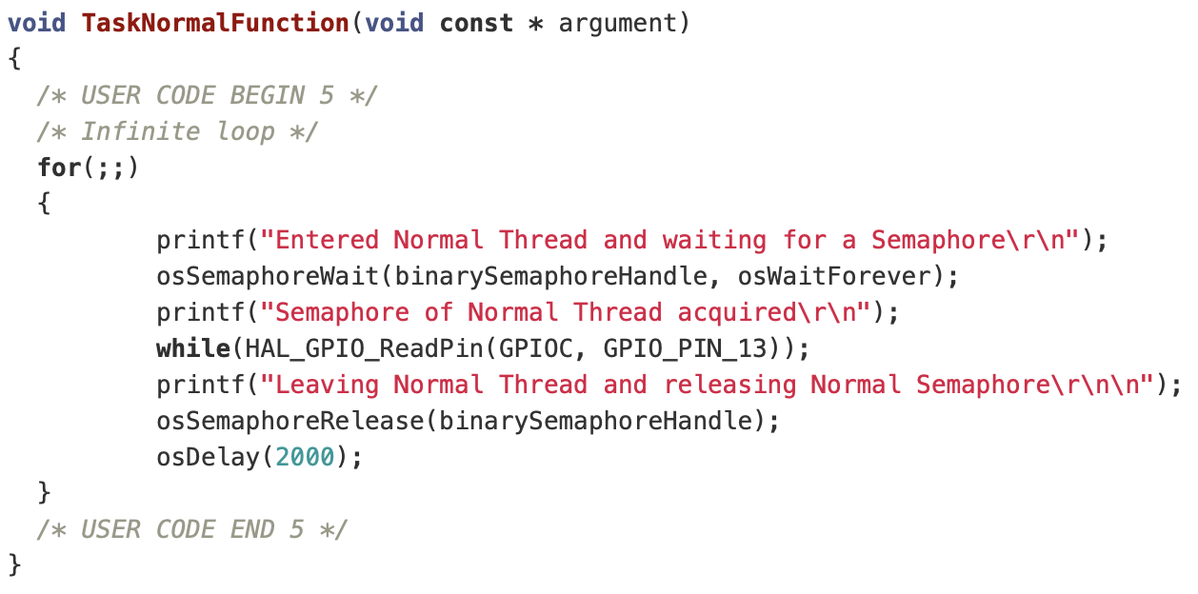
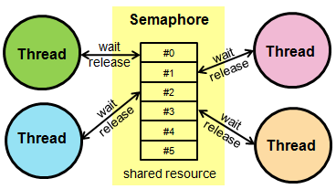
Binary Semaphore
Semaphores are used to synchronize tasks with other events in the system. Waiting for semaphore is equal to wait() procedure, task is in a blocked state not taking CPU time.

Slide 6
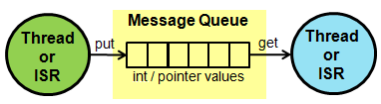
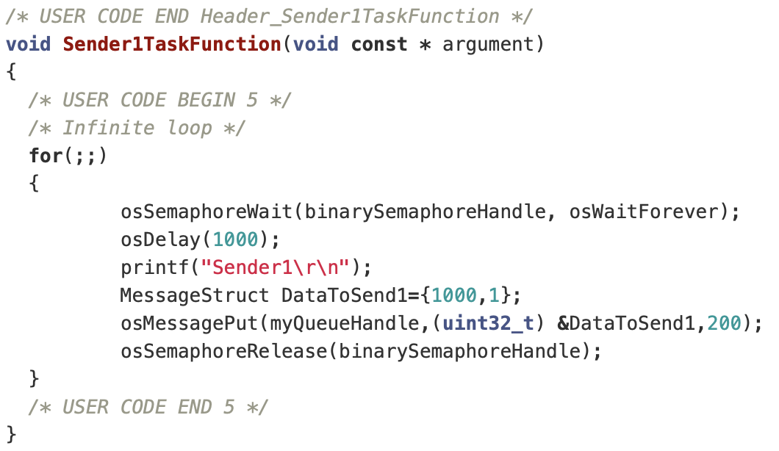
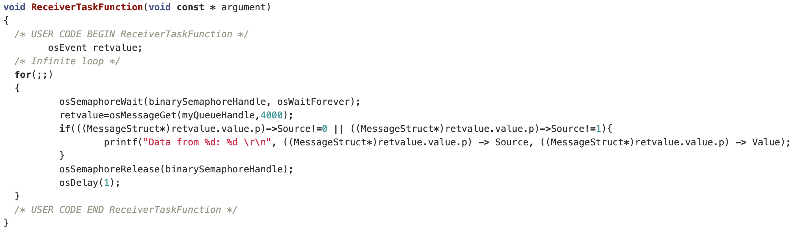
Message Queue
A Message Queue is the basic communication model between threads. The data is passed from one thread to another in a FIFO-like operation, and the queue is made by integers or pointers elements 32-bit long.

Slide 7
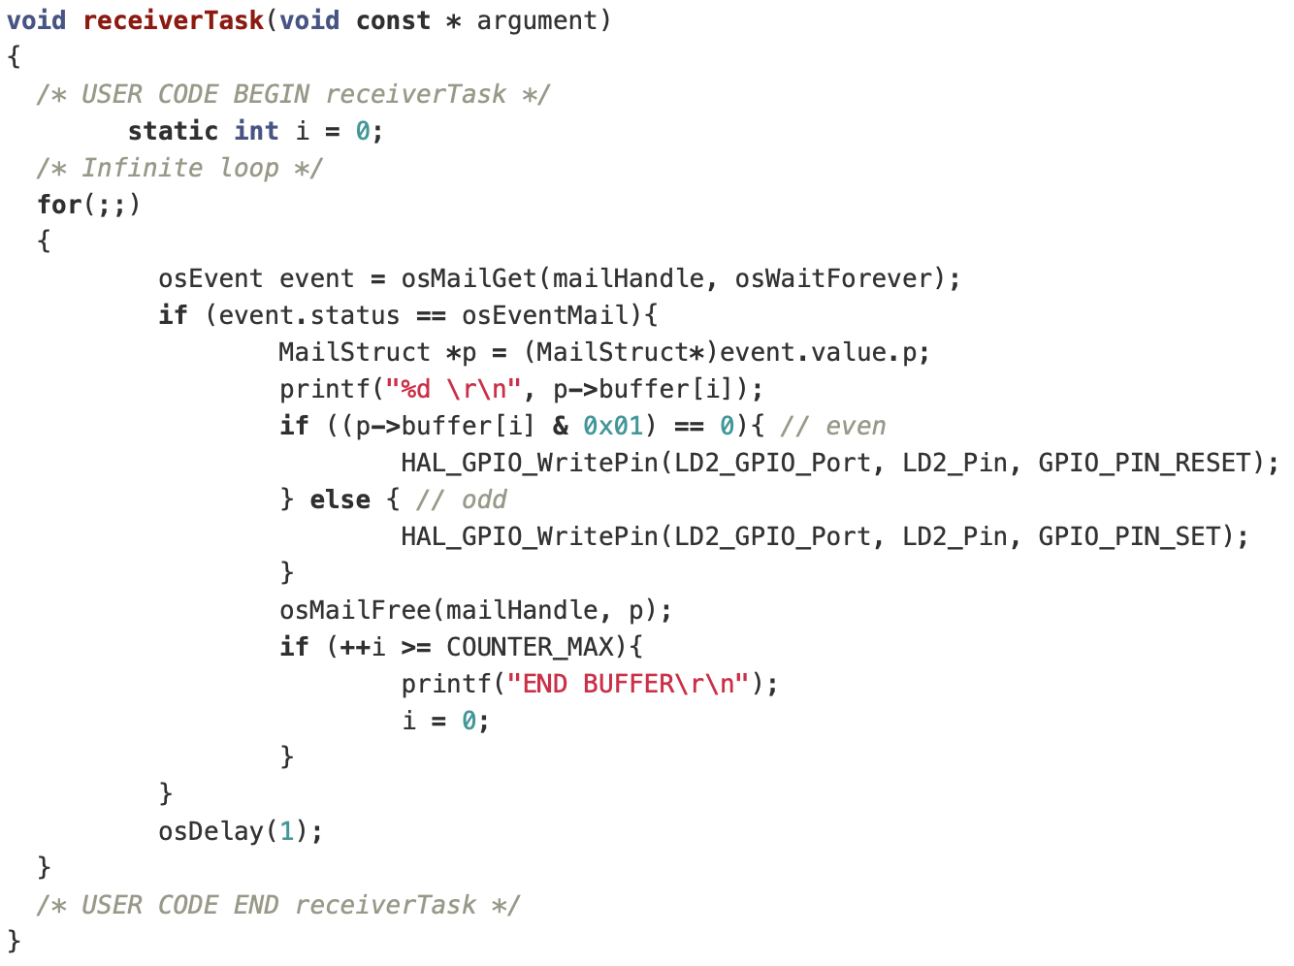
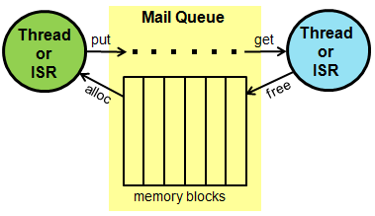
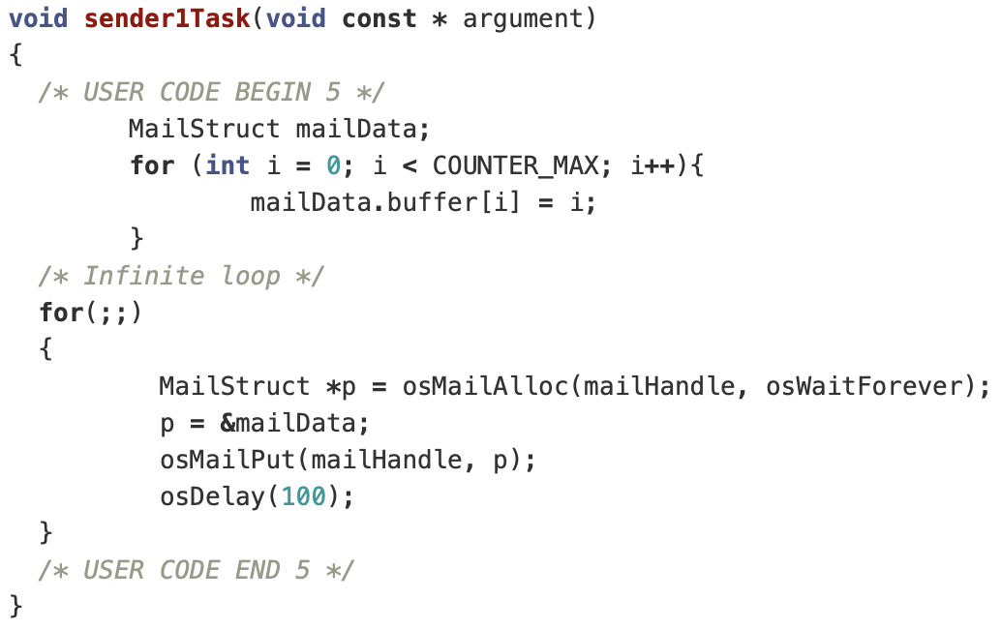
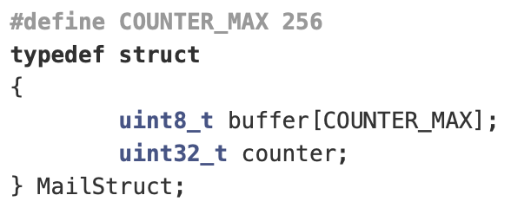
Mail Queue
A Mail Queue operates similarly to a Message Queue, but instead of transferring a 32-bit value, the data that is being transferred consists of memory blocks that need to be allocated, before putting data in, and free-up, after taking data out.

Slide 8
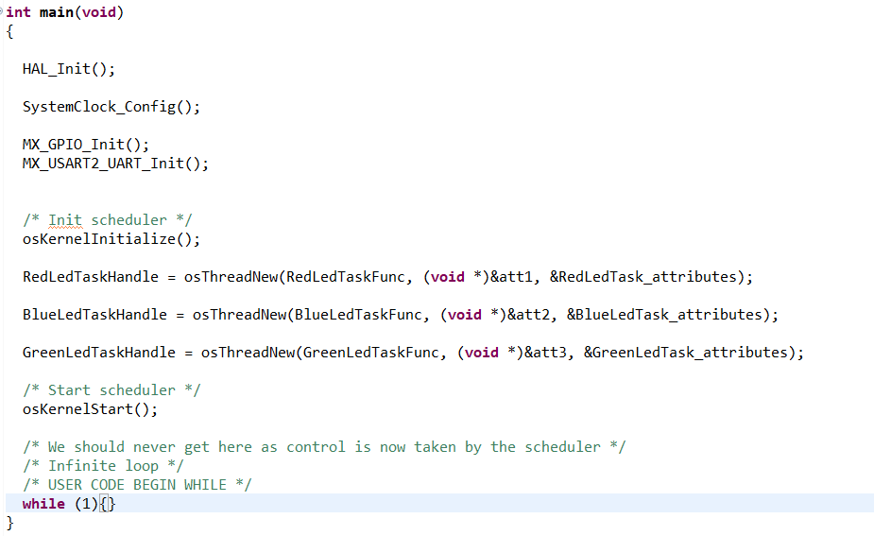
Timeline Scheduling – Understanding FreeRTOS scheduling
Peripheral Configuration
Task Initialization
Start Scheduler

Slide 9
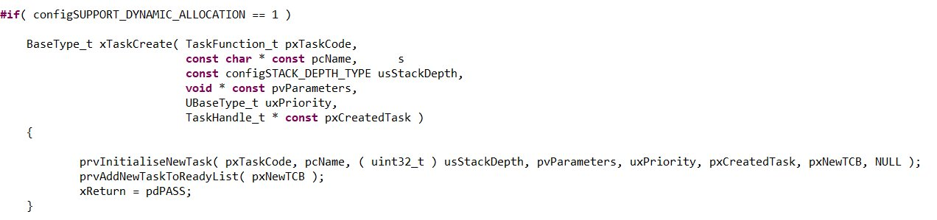
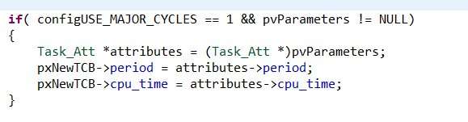
Timeline Scheduling – Understanding FreeRTOS scheduling

Slide 10
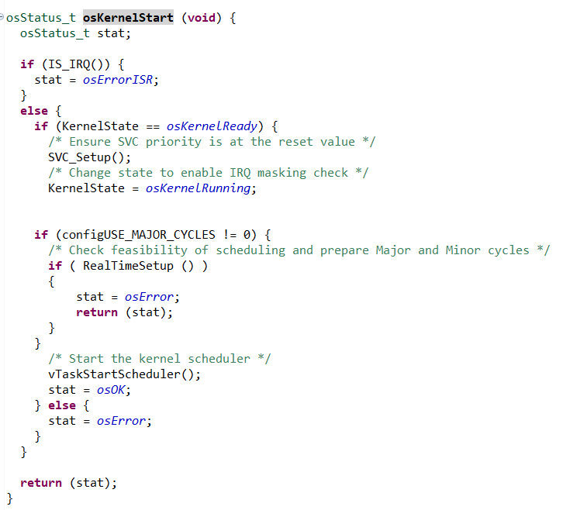
Timeline Scheduling – Understanding FreeRTOS scheduling
Before starting scheduler, call RealTimeSetup()
But first... FreeRTOSConfig.h

Slide 11
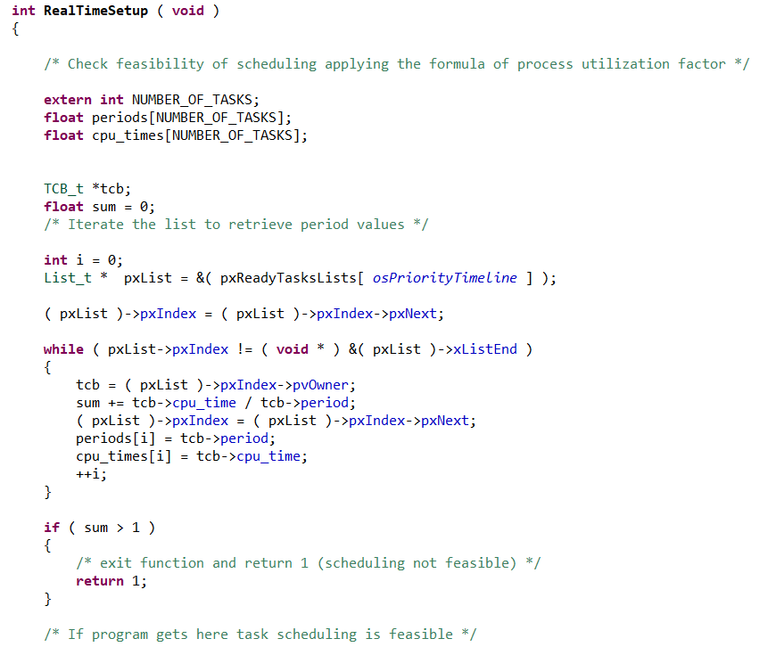
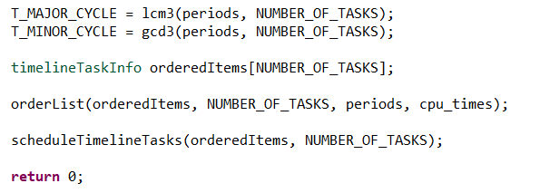

Timeline Scheduling – Understanding FreeRTOS scheduling
Check feasibility of scheduling by applying formula
Order tasks based on period
Apply algorithm to schedule tasks
$$\sum_{i}{\frac{C_{i}}{T_{i}}}≤1$$
Feasibility of timeline scheduling:

Slide 12
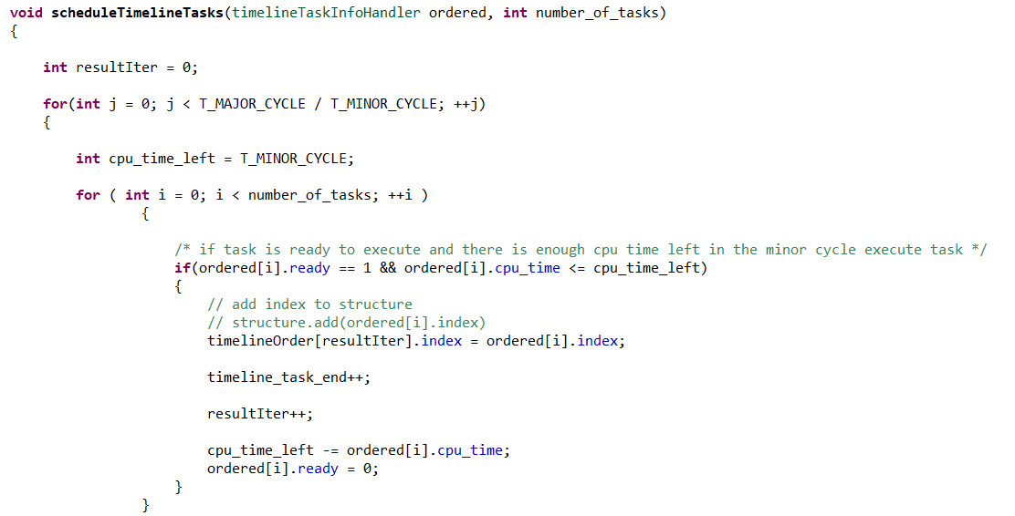
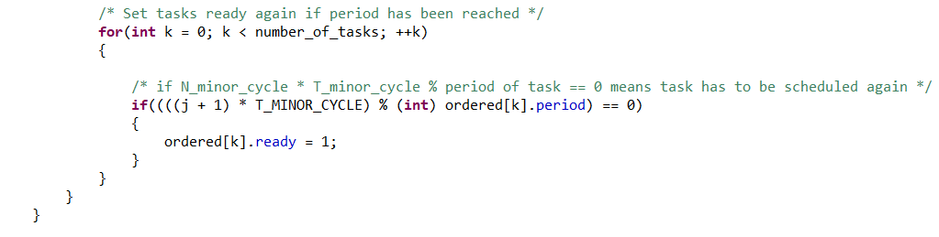
Timeline Scheduling – Understanding FreeRTOS scheduling
Simplified pseudo-code...

Slide 13
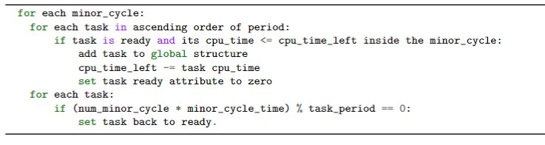
Timeline Scheduling – Understanding FreeRTOS scheduling

Slide 14
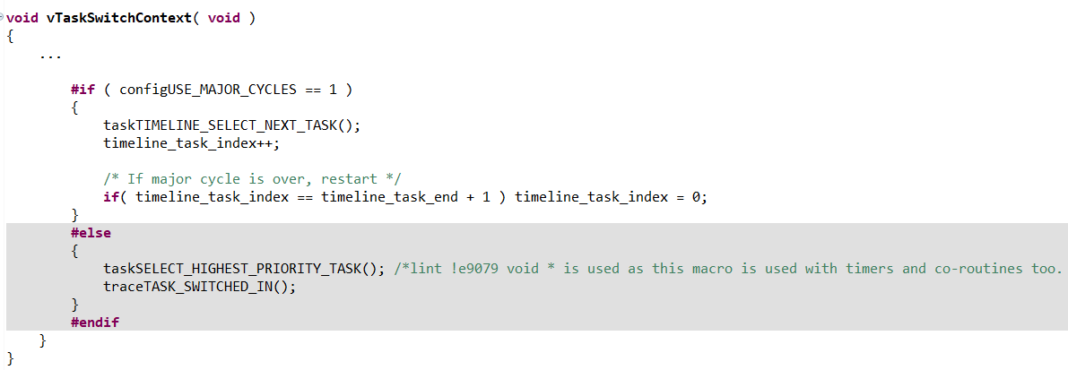
Timeline Scheduling – Understanding FreeRTOS scheduling
What happens at context switch?

Slide 15
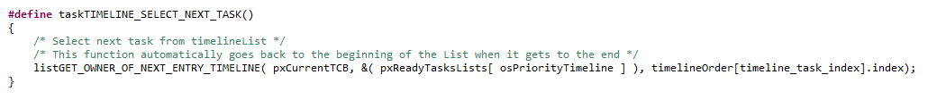
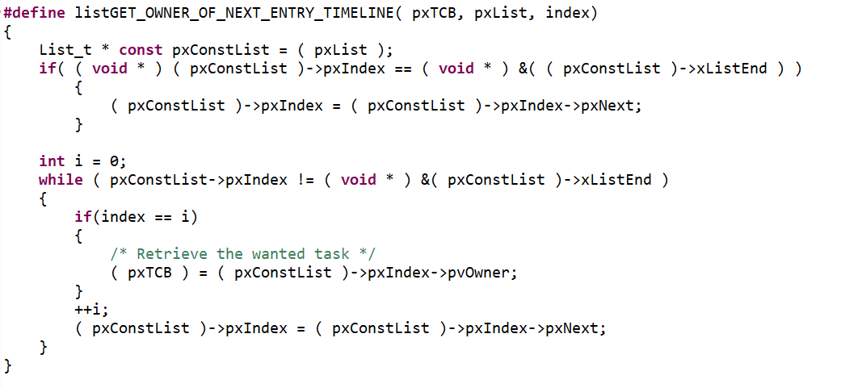
Timeline Scheduling – Understanding FreeRTOS scheduling
What happens at context switch?
Retrieve the next task TCB thanks to the index passed as parameter

Slide 16

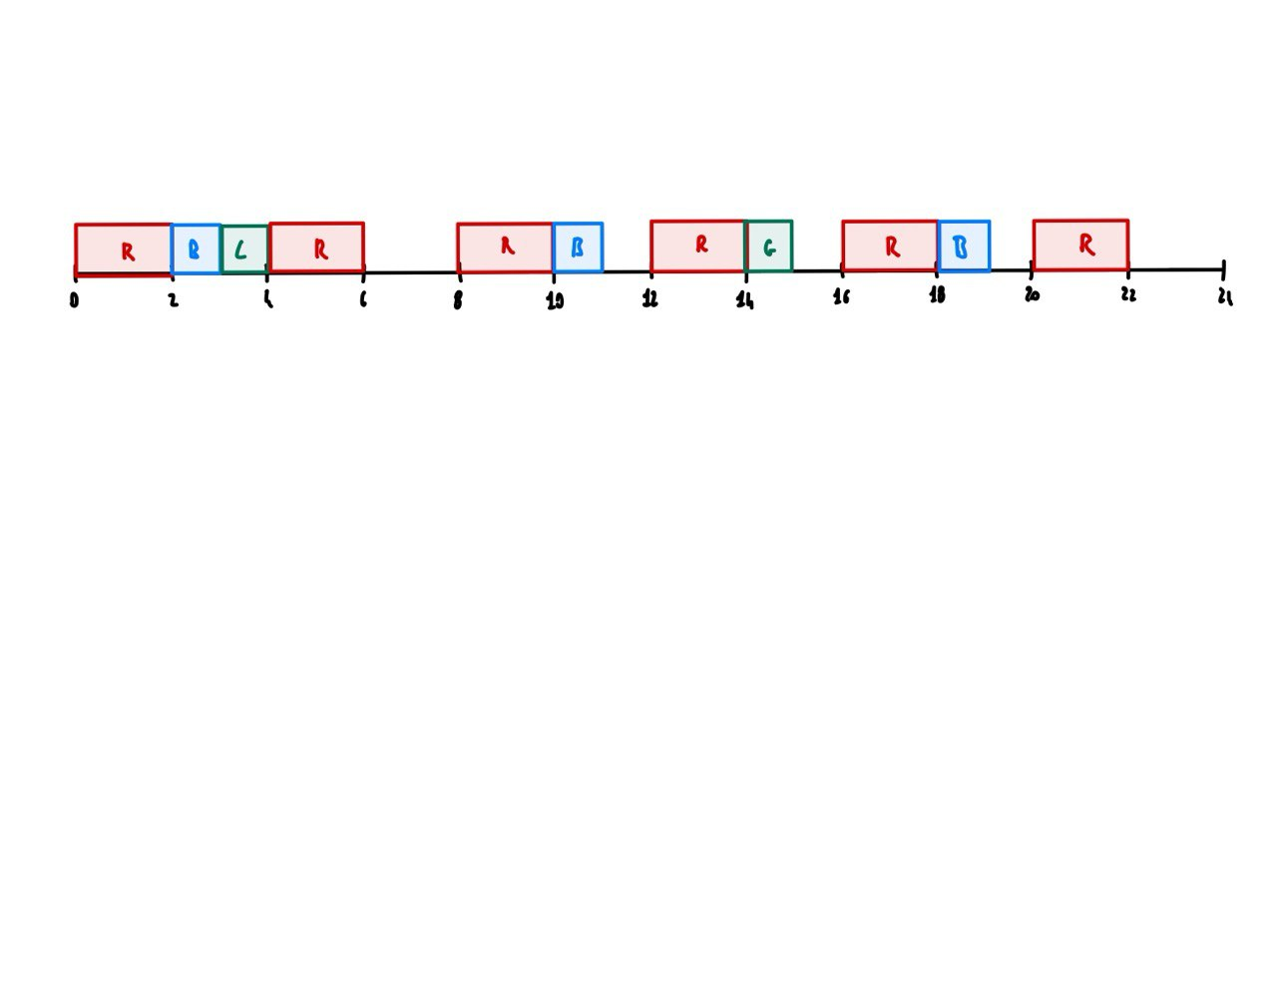
Timeline Scheduling – Example showcase
Red Led Task:
cpu_time: 2
period: 4
Blue Led Task:
cpu_time: 1
period: 8
Green Led Task:
cpu_time: 1
period: 12

Slide 17

Benchmark and evaluations
New functionalities in freeRTOS
Possibility to run real time tasks

Slide 18
THANKS!

